Slide 1
Good Afternoon

Slide 2
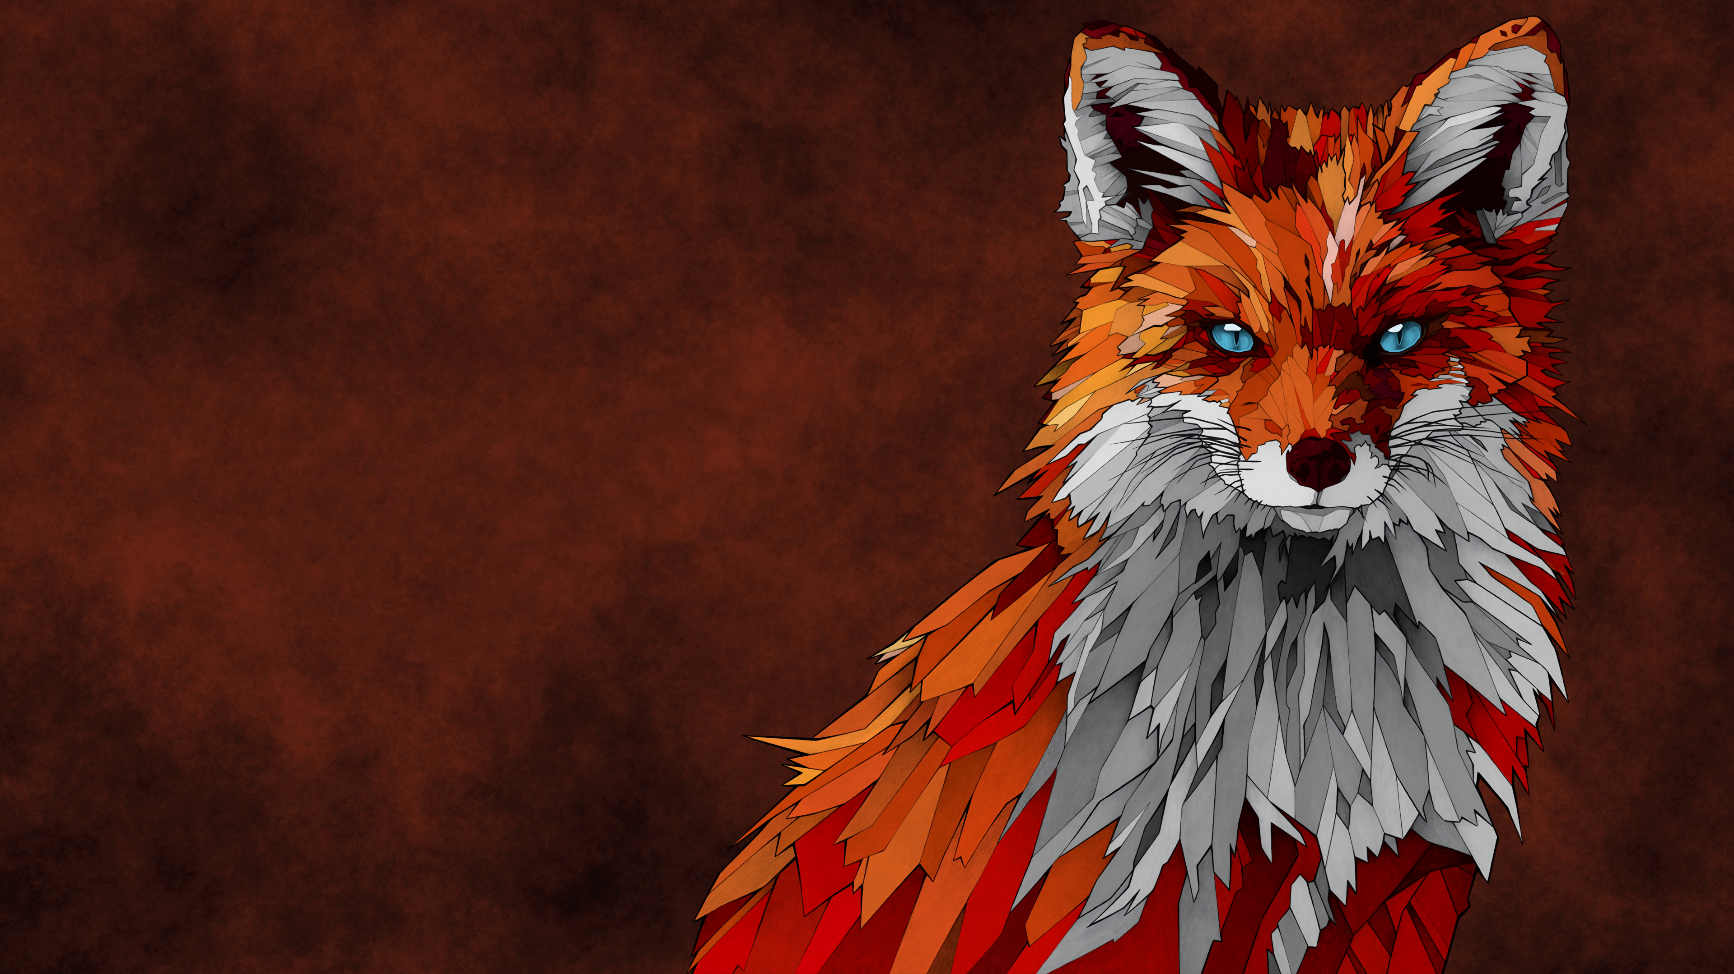


Formation
Learning
Experience

Slide 3
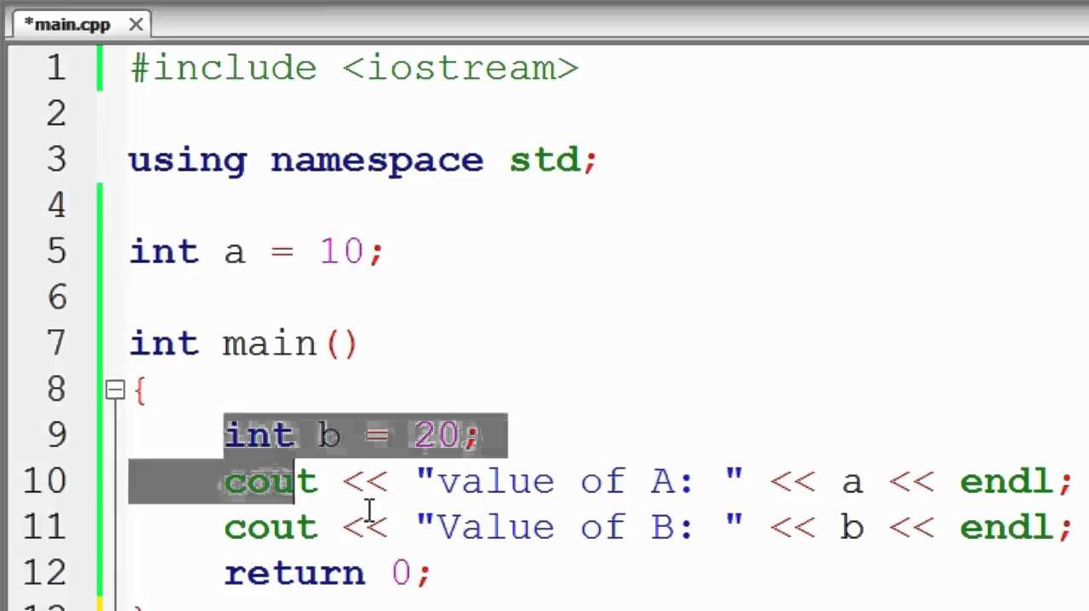
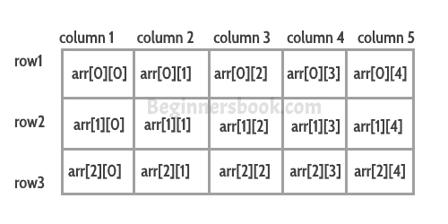
Learning
Variable
Array

Slide 4
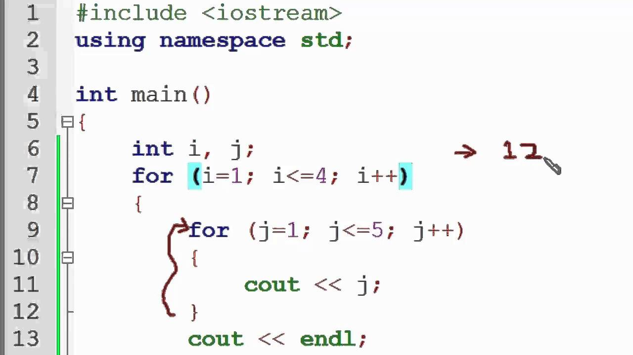
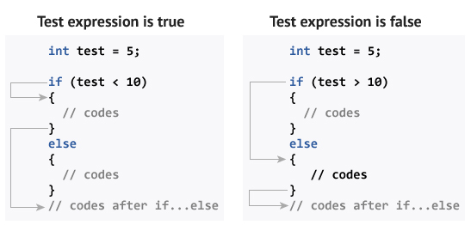
Learning
If / Else
For loop

Slide 5
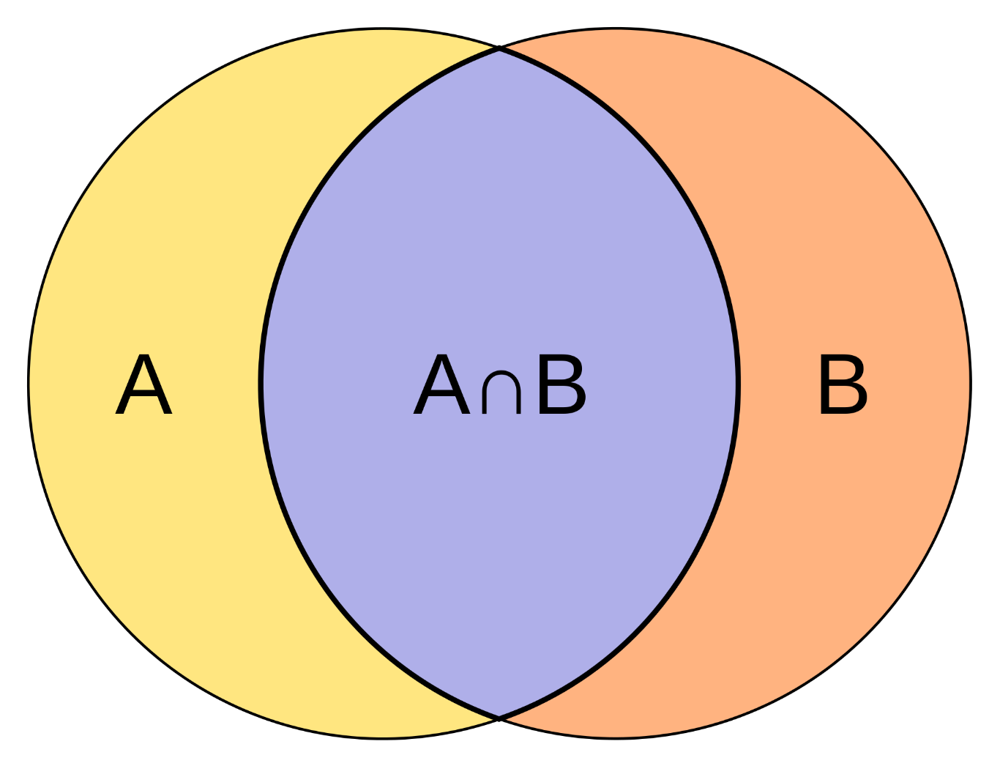
Experience

Slide 6
Thank you for your attention

